Slide 1
DSE 6220
Big Data
Hadoop & Spark
Week 4

Slide 2
Apache Spark’s Structured APIs
Chapter 3

Slide 3
What’s Underneath an RDD
Contents
What it lacks
Dependencies
List that instructs Spark how an RDD is constructed with its inputs
Allows Spark to recreate an RDD and replicate operations on it which gives it resiliency
Partitions
Gives the ability to split the work to parallelize computation on partitions across executors.
Locality can be used to send work to the executors that are close to the data.
Compute Function: Partition => Iterator[T]
The compute function produces an Iterator[T] for the data that will be stored in the RDD.
Causes opacity due to serialization which hampers Spark’s ability to rearrange your computation into an efficient query plan.
RDDs lack structure
See the RDD_Example.ipynb notebook for clarity
RDDs lack uniformity across components and languages.
Garbage collection
No input optimization engine
Overhead of serialization
Degrades when they have less memory
When to use RDDs
Are using a third-party package that’s written using RDDS
Can forgo the code optimization, efficient space utilization, and performance benefits available with DataFrames and Datasets
Want to precisely instruct Spark how to do a query

Slide 4
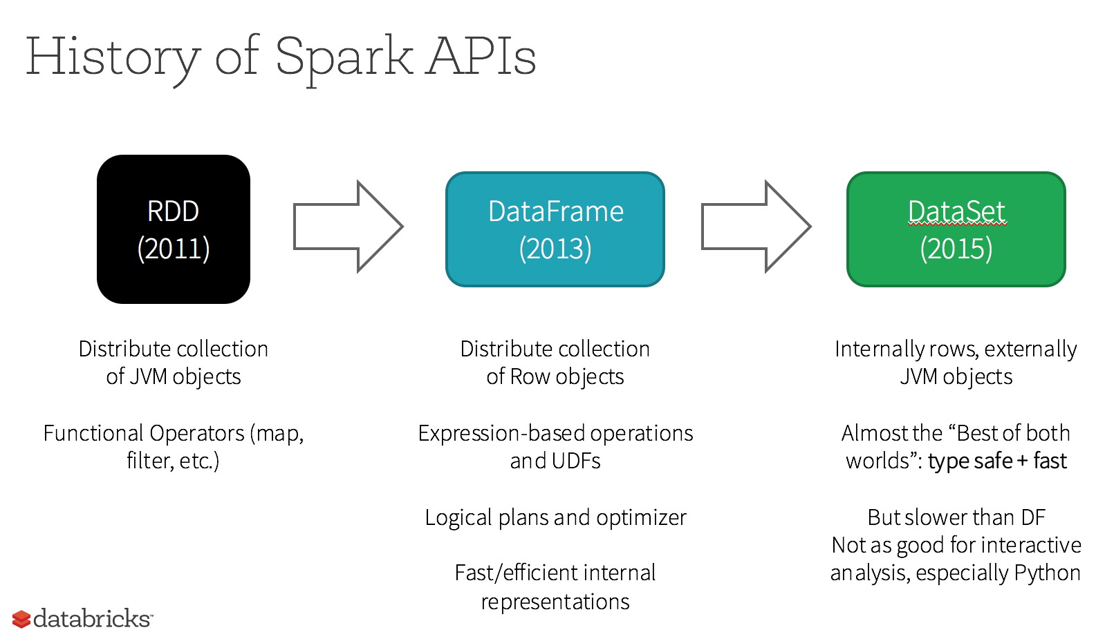

Slide 5
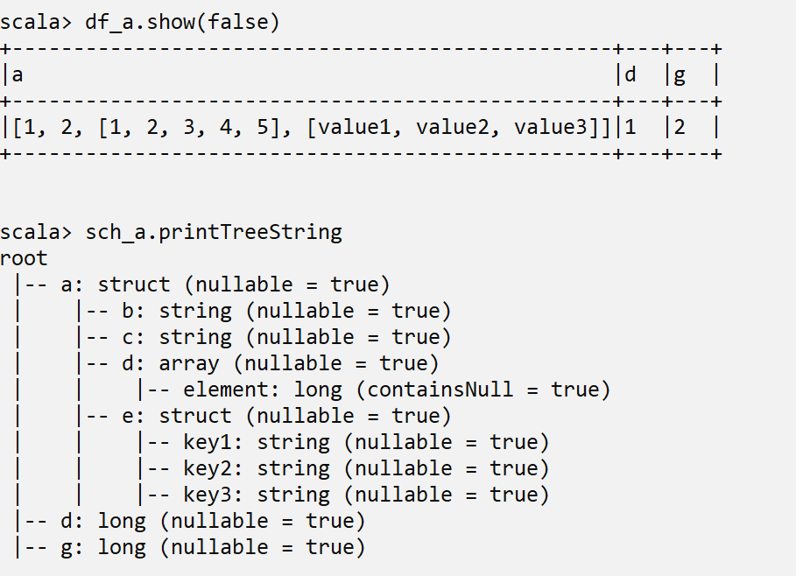
The DataFrame API
Inspired by Pandas DataFrames
Easy to understand and easy to work with when it comes to common operations you might want to execute on rows and columns.
DataFrames are immutable (Spark creates a data lineage)

Slide 6
Data type | Value type in Python | API to access or create a data type
ByteType | int or long Note: Numbers will be converted to 1-byte signed integer numbers at runtime. Please make sure that numbers are within the range of -128 to 127. | ByteType()
ShortType | int or long Note: Numbers will be converted to 2-byte signed integer numbers at runtime. Please make sure that numbers are within the range of -32768 to 32767. | ShortType()
IntegerType | int or long | IntegerType()
LongType | long Note: Numbers will be converted to 8-byte signed integer numbers at runtime. Please make sure that numbers are within the range of -9223372036854775808 to 9223372036854775807. Otherwise, please convert data to decimal.Decimal and use DecimalType. | LongType()
FloatType | float Note: Numbers will be converted to 4-byte single-precision floating point numbers at runtime. | FloatType()
DoubleType | float | DoubleType()
DecimalType | decimal.Decimal | DecimalType()
StringType | string | StringType()
BinaryType | bytearray | BinaryType()
BooleanType | bool | BooleanType()
TimestampType | datetime.datetime | TimestampType()
TimestampNTZType | datetime.datetime | TimestampNTZType()
DateType | datetime.date | DateType()
DayTimeIntervalType | datetime.timedelta | DayTimeIntervalType()
ArrayType | list, tuple, or array | ArrayType(elementType, [containsNull]) Note:The default value of containsNull is True.
MapType | dict | MapType(keyType, valueType, [valueContainsNull]) Note:The default value of valueContainsNull is True.
StructType | list or tuple | StructType(fields) Note: fields is a Seq of StructFields. Also, two fields with the same name are not allowed.
StructField | The value type in Python of the data type of this field (For example, Int for a StructField with the data type IntegerType) | StructField(name, dataType, [nullable]) Note: The default value of nullable is True.
Data Types
(Pyspark)
Documentation

Slide 7
Schemas, DataFrames, Expressions
Schemas
Data Frames
Defines the column names
Defines the data types
Can be inferred from the data or can be explicitly set
Two ways to create:
StructTypes
DDLs
See the Week4 Examples
DataFrames are created with the spark session object (not the context)
spark.createDataFrame(data, schema)
Data can be a list of lists or list of tuples.
Remember from 6210 a ‘row’ is a ‘tuple’.

Slide 8
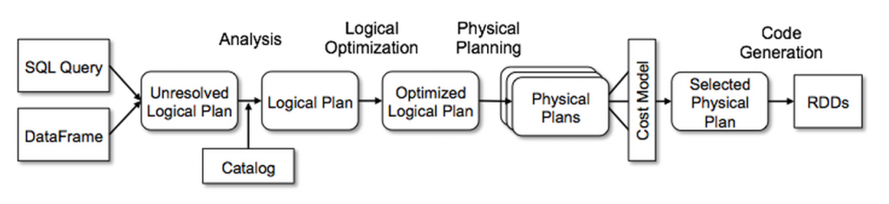
Catalyst Optimizer
Analysis
Logical optimization
Physical planning
Code generation

Slide 9
See Notebook Examples

